Slide 1

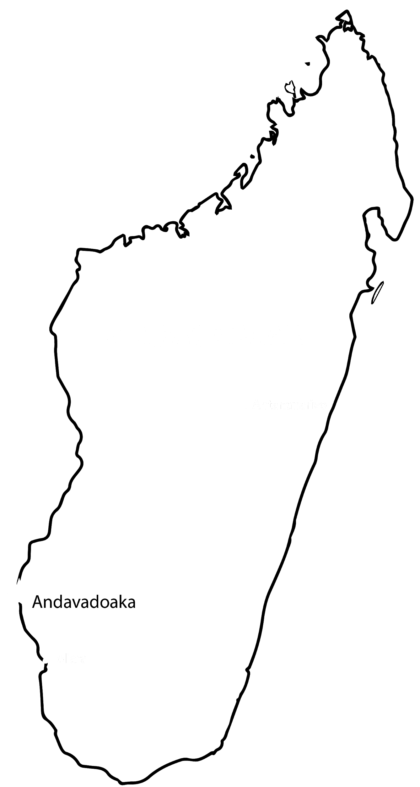
Estimating Substitution Trends in the Mitochondrial Genome of Madagascar Snakes
Renee Jean-Baptiste (TYWLS of Queens)
Crystal Lin (TYWLS of Queens)
Odelia Lorch (HSMSE)
Ava Mohajer (the Dalton School)
Stephanie Pinto (Forest Hills HS)
Elena Urquiola (Hunter HS)

Slide 2
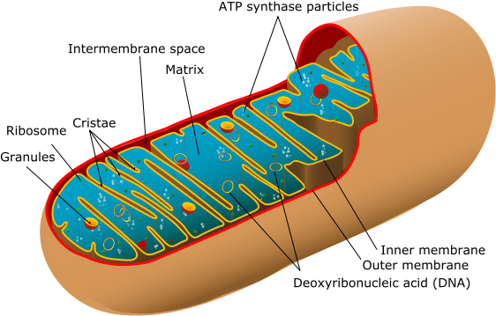
Mitochondria
Notes:
l
MITOCHONDRIA
Explain what mitochondria does
Mitochondria is an organelle in the cell that makes energy
What it is, what is does, and why it is important
It’s important b/c it gives vertebrates energy
It wasn't part of our bodies
This produces energy and it was its own free oganism
It has its own genome and one control region
Mitochondrial genomes are conserved throughout all vertebrates (same genes as all other animals) - makes it easier to study evolution b/c can compare common genes
Everytime you breathe you produce millions of ATP
Every cell has its own genome

Slide 3
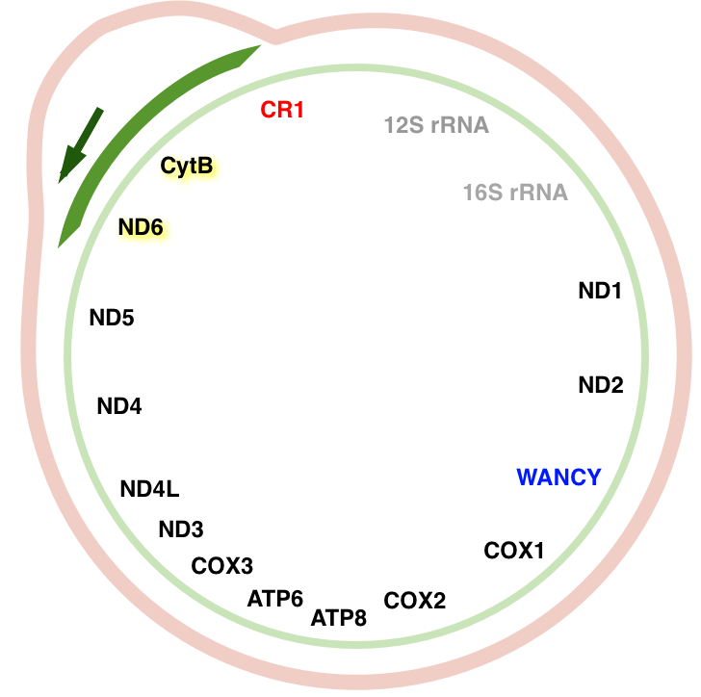
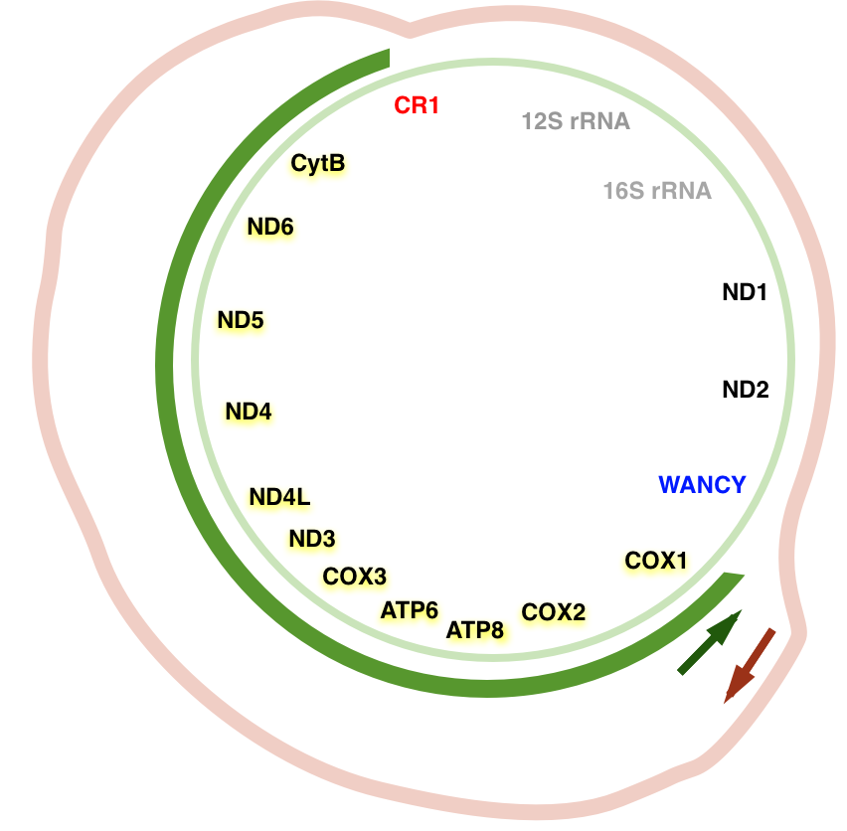
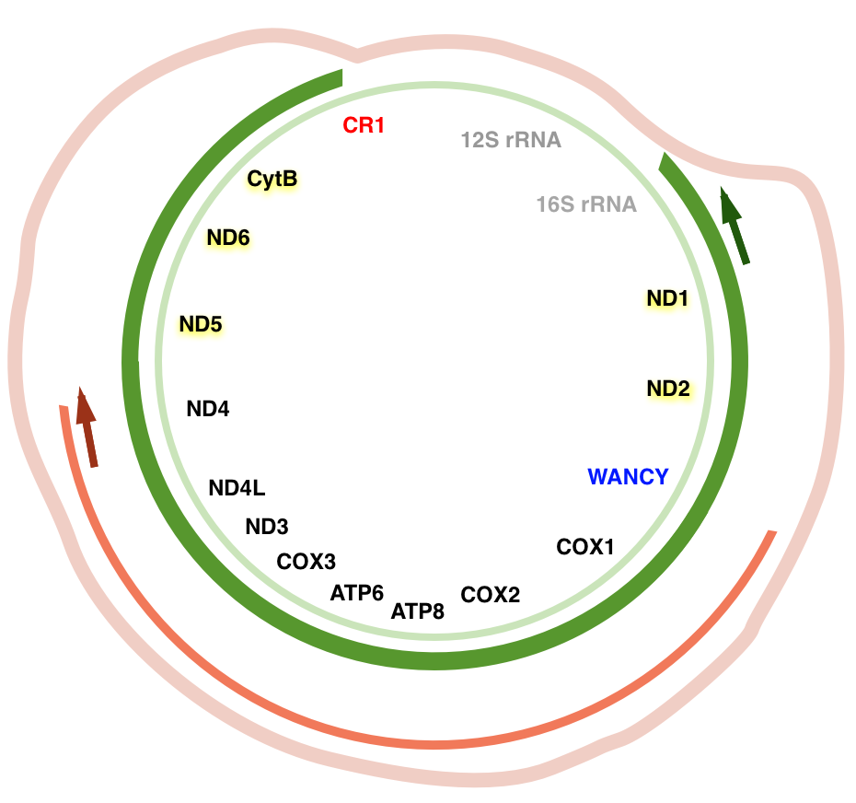
Replication
substitution: an identifiable mutation in the DNA
control region: the region where the mtDNA opens up
WANCY: the region where the mtDNA starts to fill in
Notes:
Started in the control region
Replication process → two rings that replicate differently
Inner ring replicates weirdly
Starts at control region
Stops at wancy
Goes around and fills in the newly opened strands
EXPLAIN IT BETTER LATER
-

Slide 4
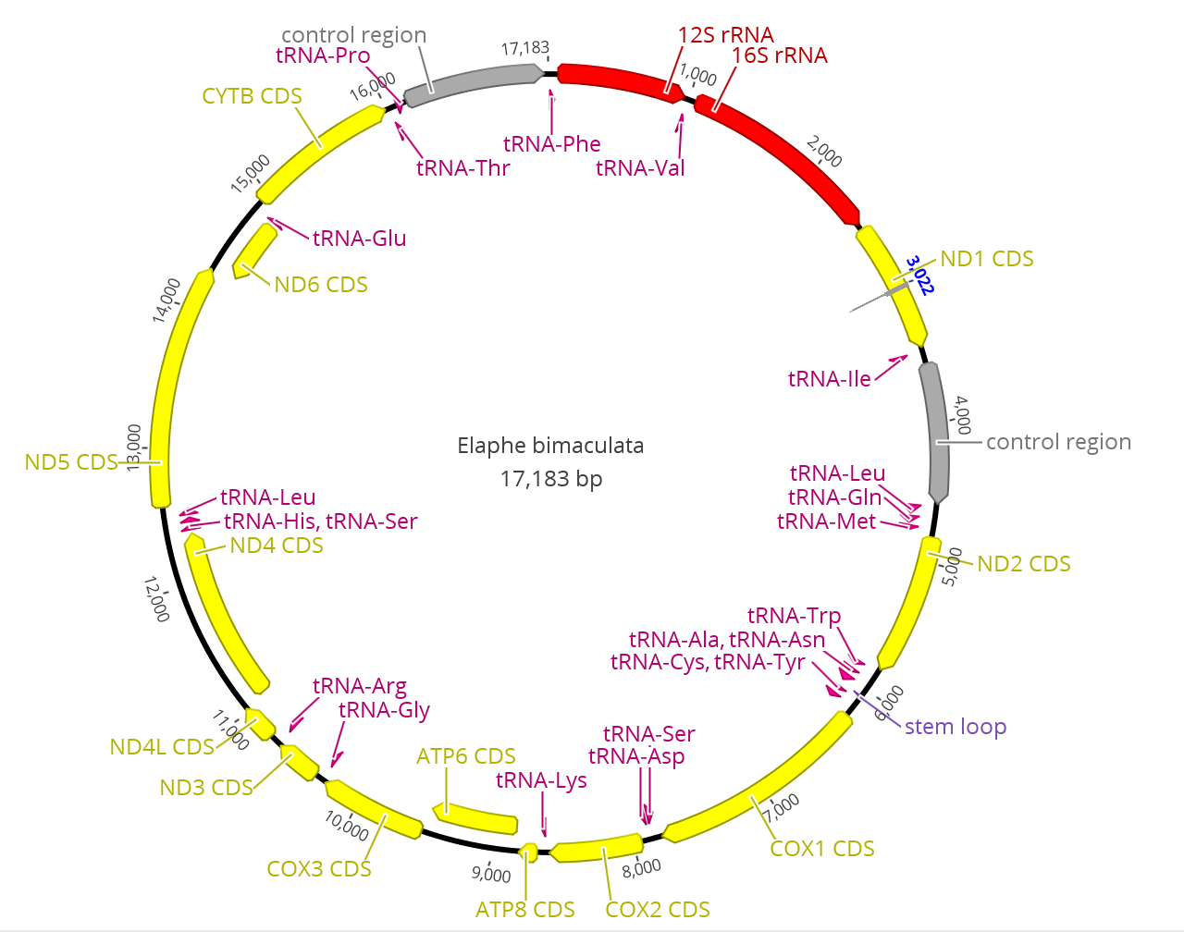
Snake Mitochondrial Genome
Notes:
Who is presenting this slide? Odelia
- Normal generic genome
-each mitochondria has its own genome
Control region initiates the replication process
is circular
replication process can be affected by the environment, which can lead to mutations
free radicals
Talk about trends
Using a statistical model to predict a physical one
We are using the statistics of how the substitutions happen to understand how the replication functionally happens mitochondria

Slide 5
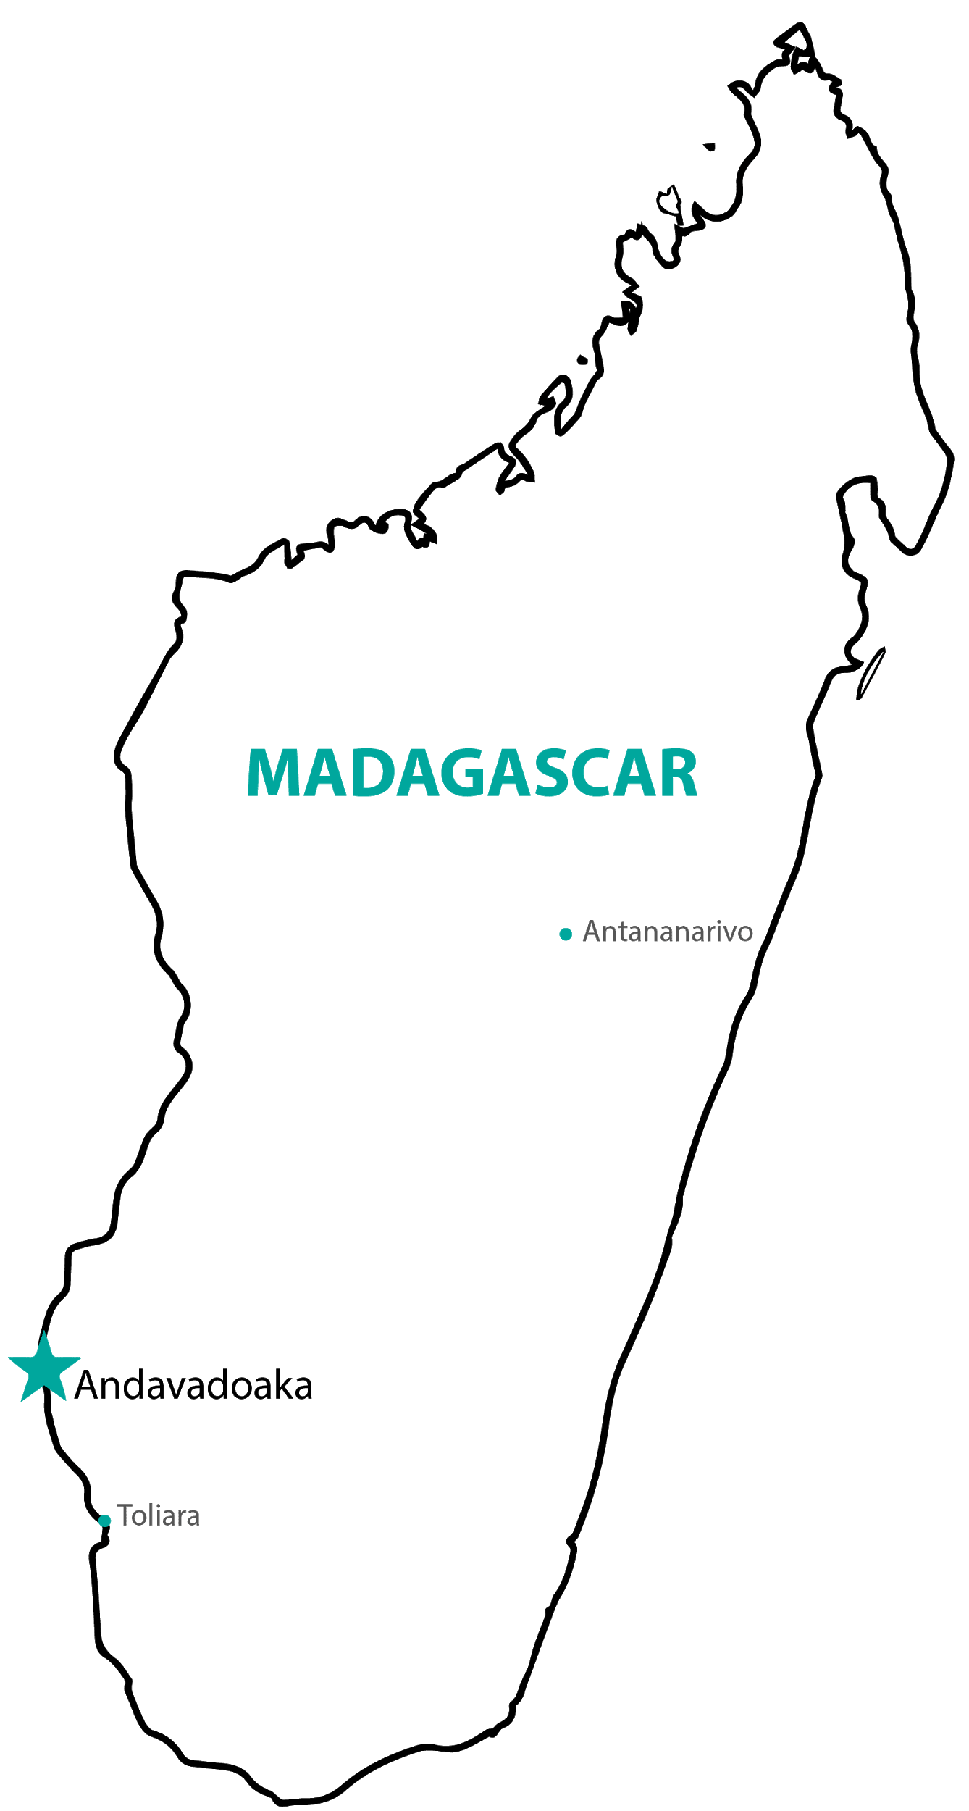
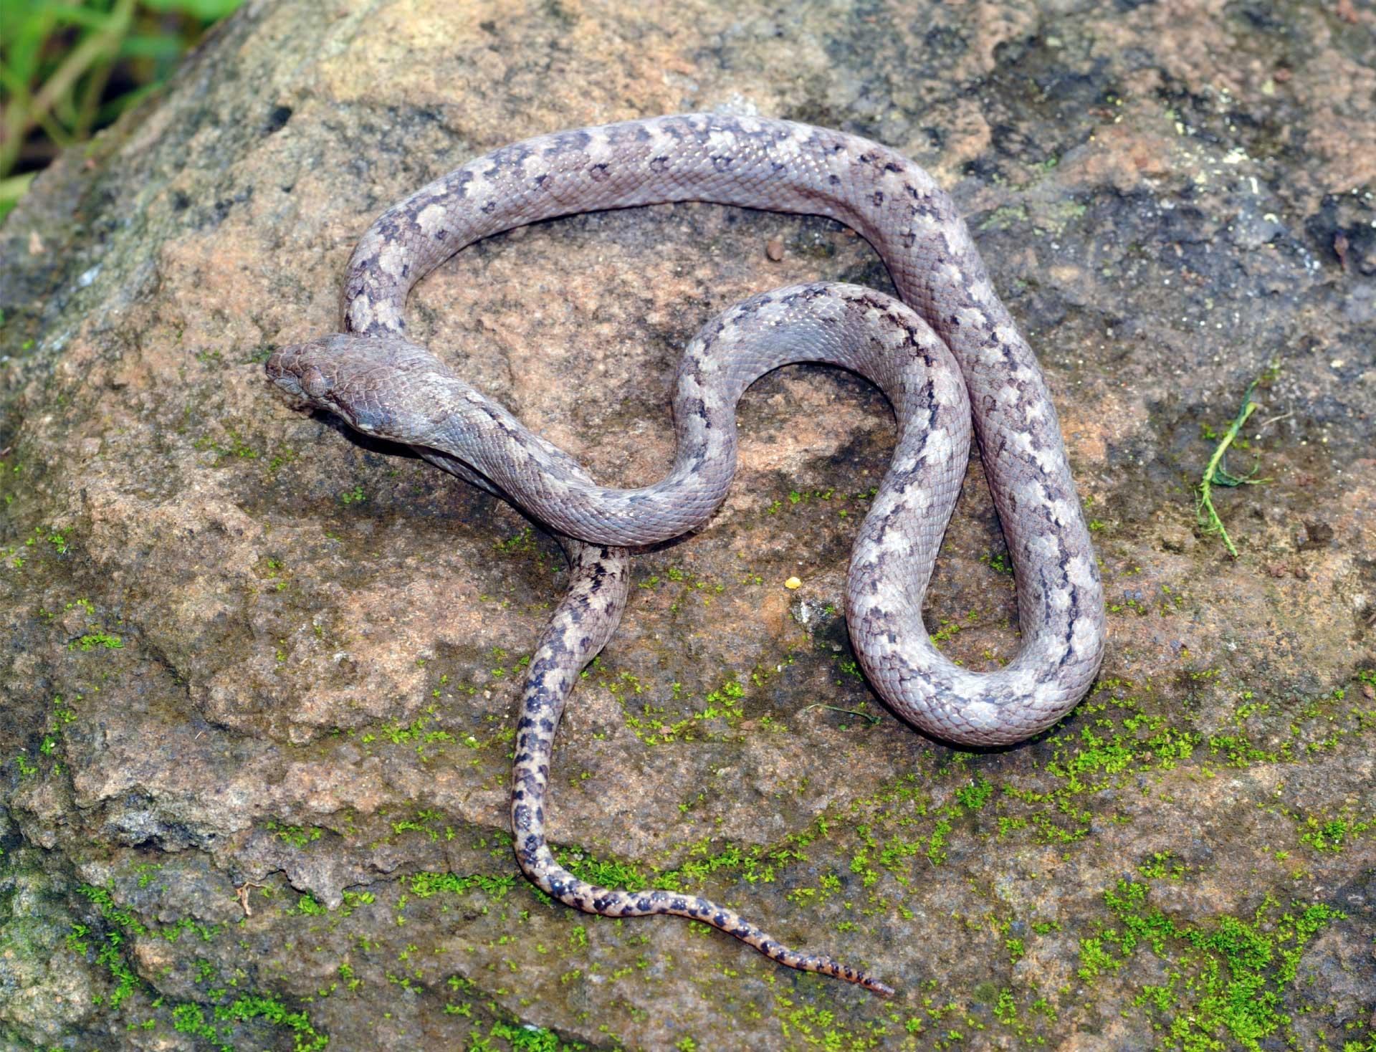
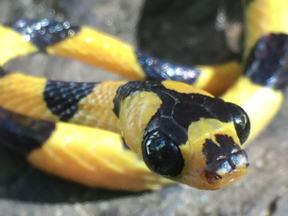
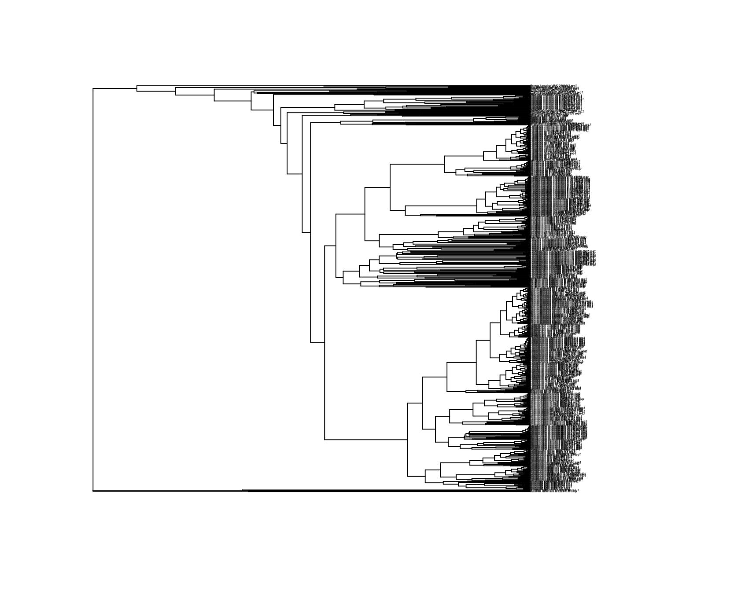
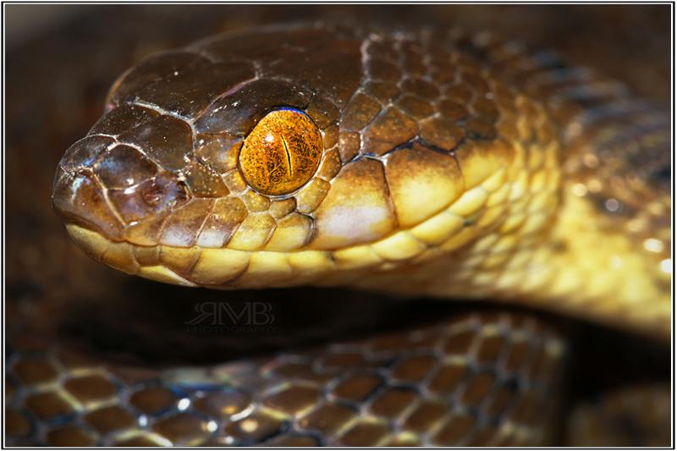
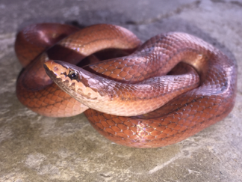
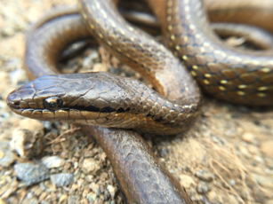
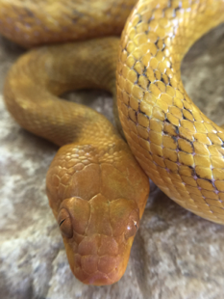
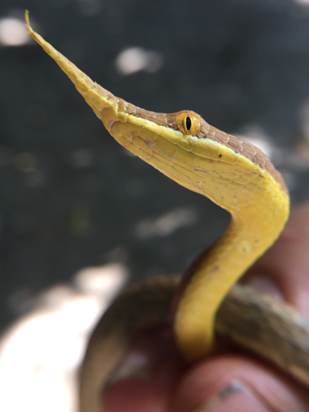
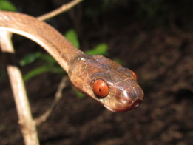
24 million years ago...
Notes:
New pictures
Explain why madagascar is so important (the migration)
Young and isolated - not much mutation yet and not many substitutions

Slide 6
Research Questions
Is there a linear relationship between substitution rates and distance from control region?
Is this a general trend? Does it occur both for individual species and between multiple species?
Notes:
Crystal
QUESTION 1:
That will tell us if time spent single stranded is related to distance from control region (will verify replication model)
As you get furthur from the orgin of replication we expect that mutation rates will increase
QUESTION 2:
Is the trend stronger intra-species or inter-species?
- if this is really how it replicates then we expect dna to change
- This will verify the replication model
- Trend?
Replication model?
Intra- or Inter-?
- the time and the distance are not separated
-

Slide 7
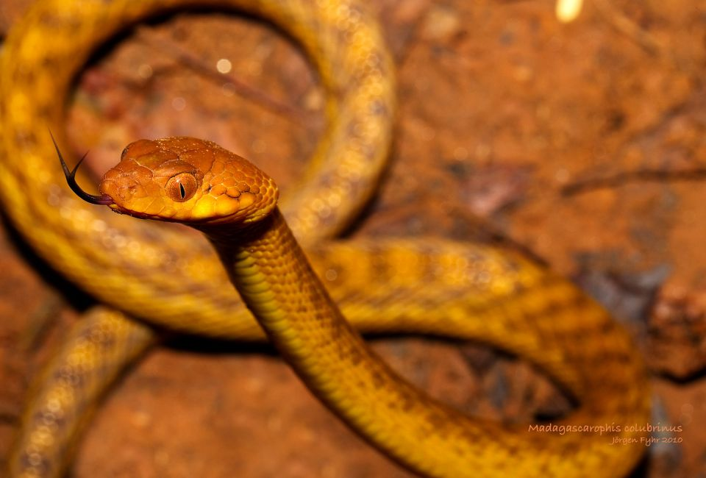
Genome assembly
Prune phylogenetic trees
Calculate substitution rates
Scatter plot
Bayesian correlation plot
Circular graph
Comparison of trend among species
Madagascarophis colubrinus
Notes:
They want to know the programs just say genome assembly on next slide

Slide 8
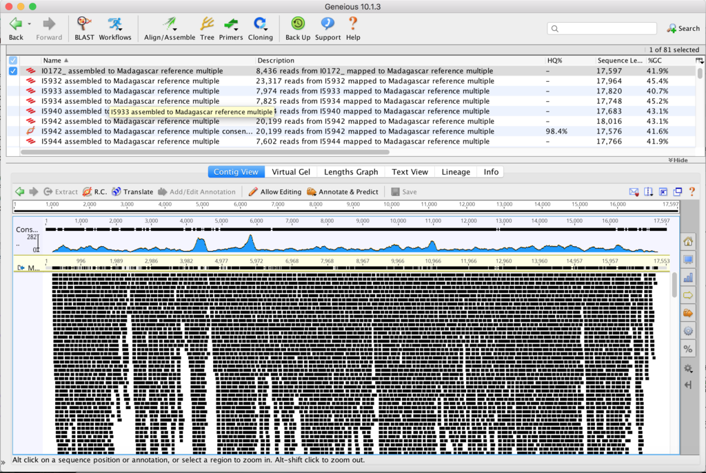
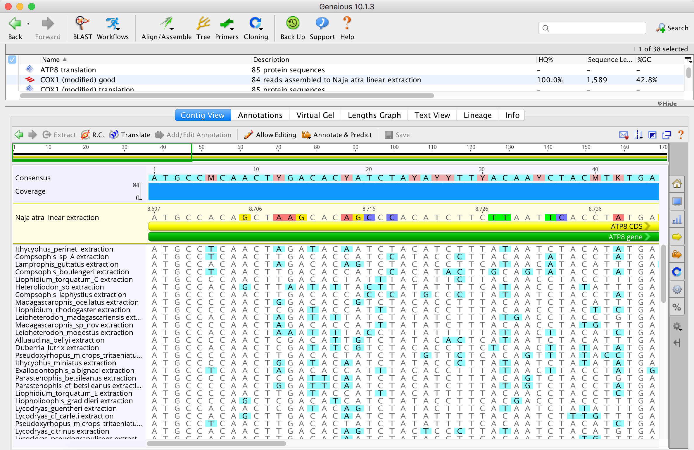

Genome Assembly
Map DNA reads to reference genome
Extract protein coding alignments from the assembled reads
Notes:
Steph
-used a tool named geneious to analyze our species.
-reads are small fragments of DNA. we used these reads to map to another snake that we get from genbank

Slide 9
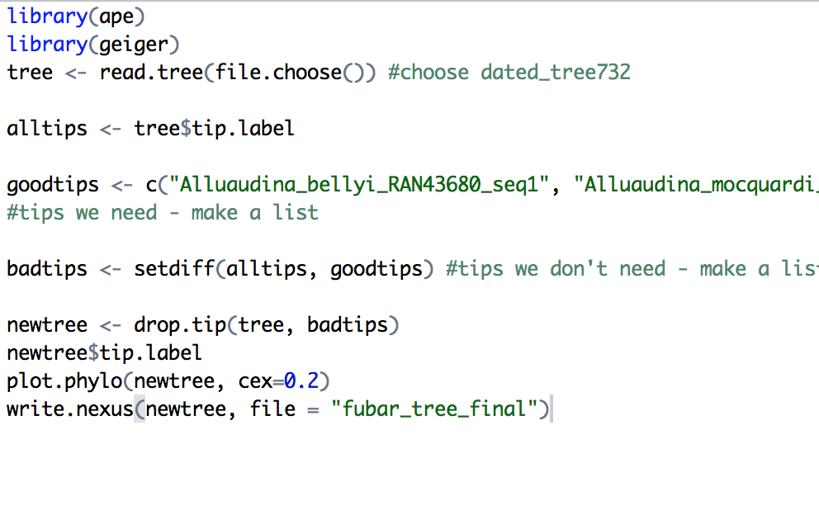
2. Pruning trees
Notes:
Steph
-we used this to cut out species on the tree that we did not use

Slide 10
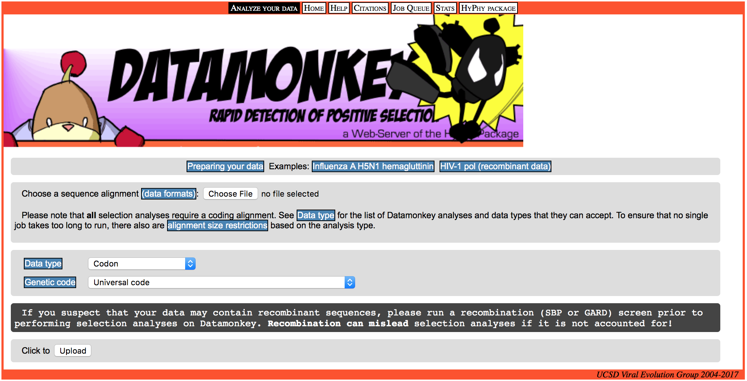
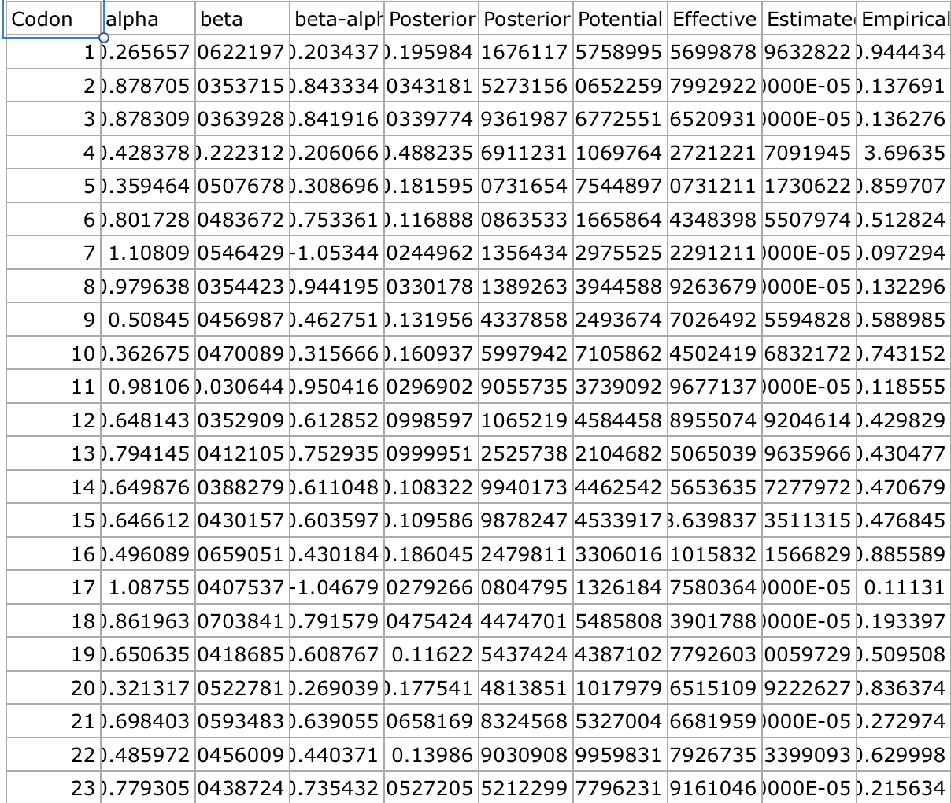
3. Calculate Substitution Rates
FUBAR (Fast Unconstrained Bayesian AppRoximation)
Computes: substitution rates (synonymous and nonsynonymous)
Output: CSV file
Notes:
Steph
-To calculate the substitution rates of the mitochondrial DNA, we used a tool called FUBAR, which stands for ___.
-We inputted out data from Geneious to FUBAR so that it could calculate the substitution rates for both synonymous and nonsynonymous mutations.
-It outputted a CSV file, or a comma separated value file, so that we could use it to generate our scatter plots.

Slide 11
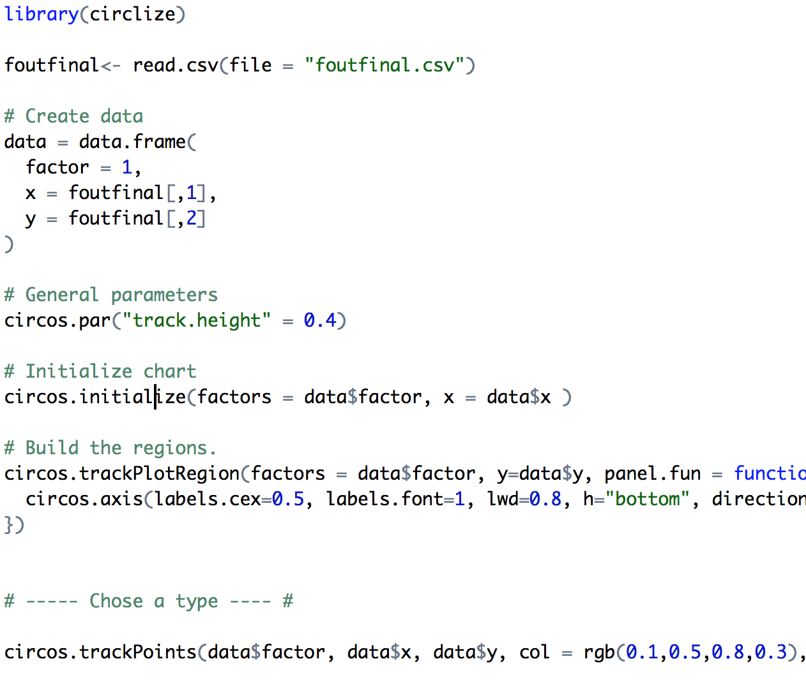
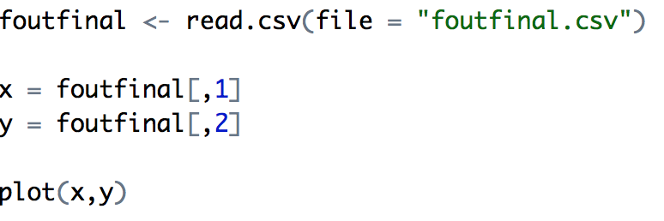
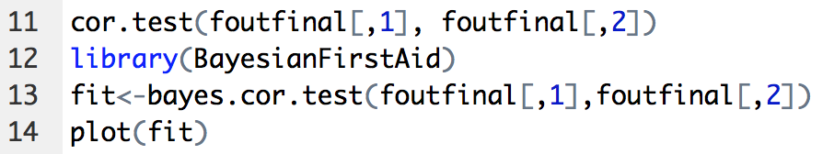
Visualization Code
Circular Plots
Scatter Plots
Bayesian Plots
Notes:
Elena

Slide 12
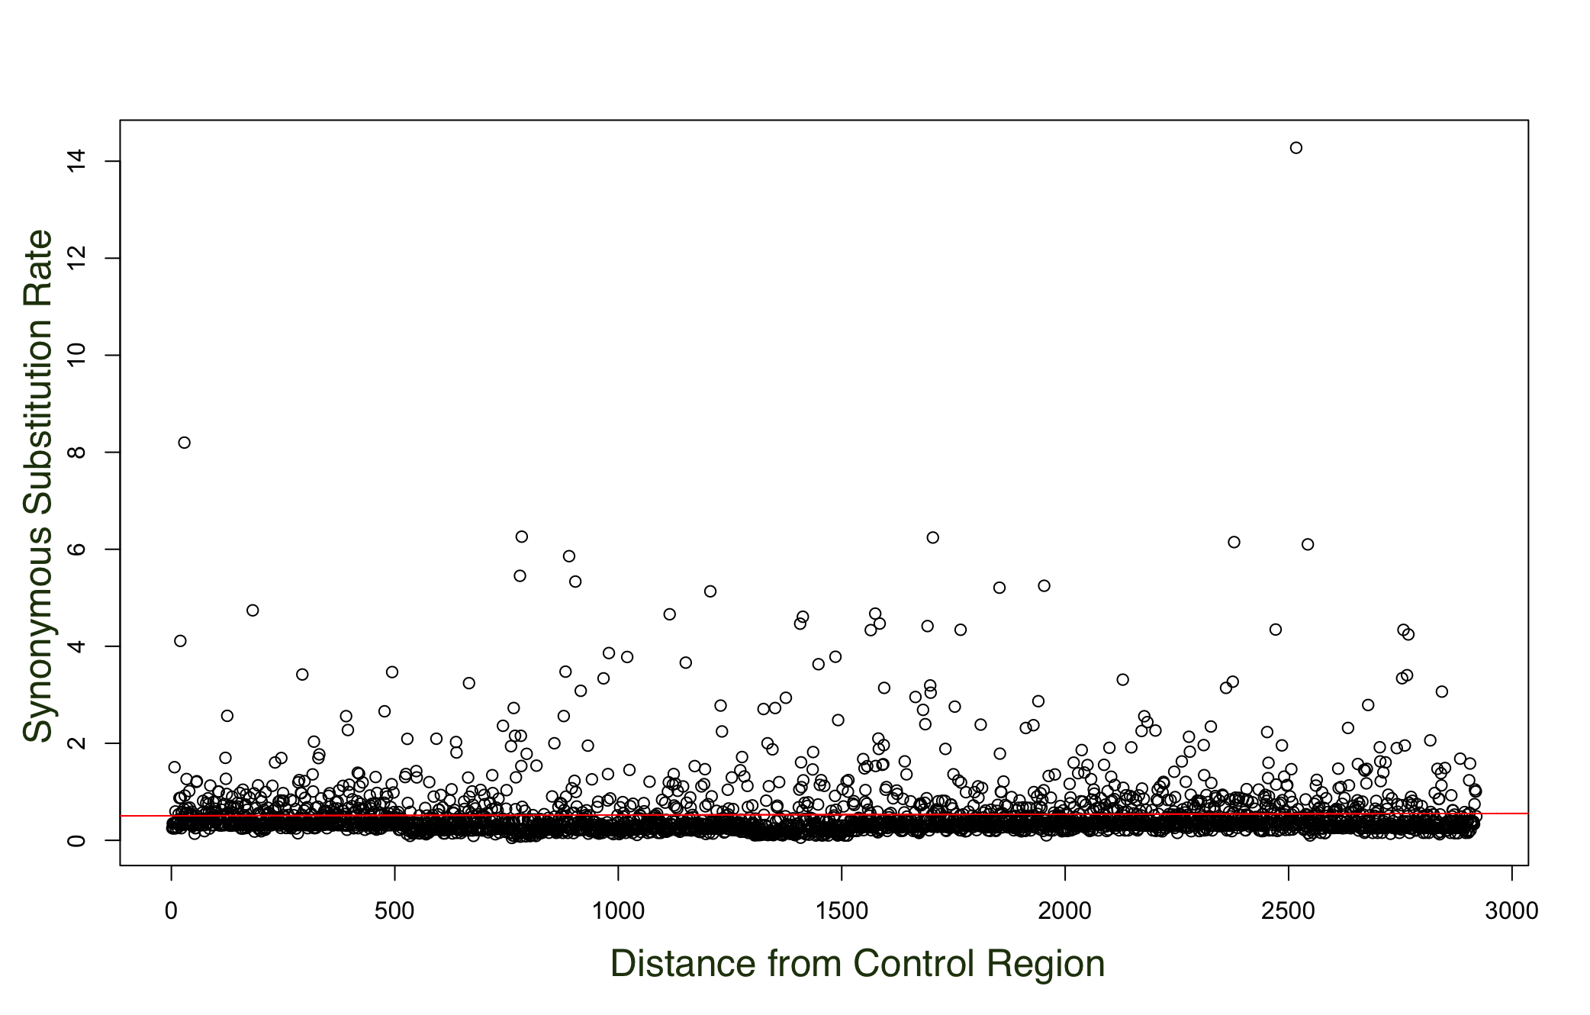
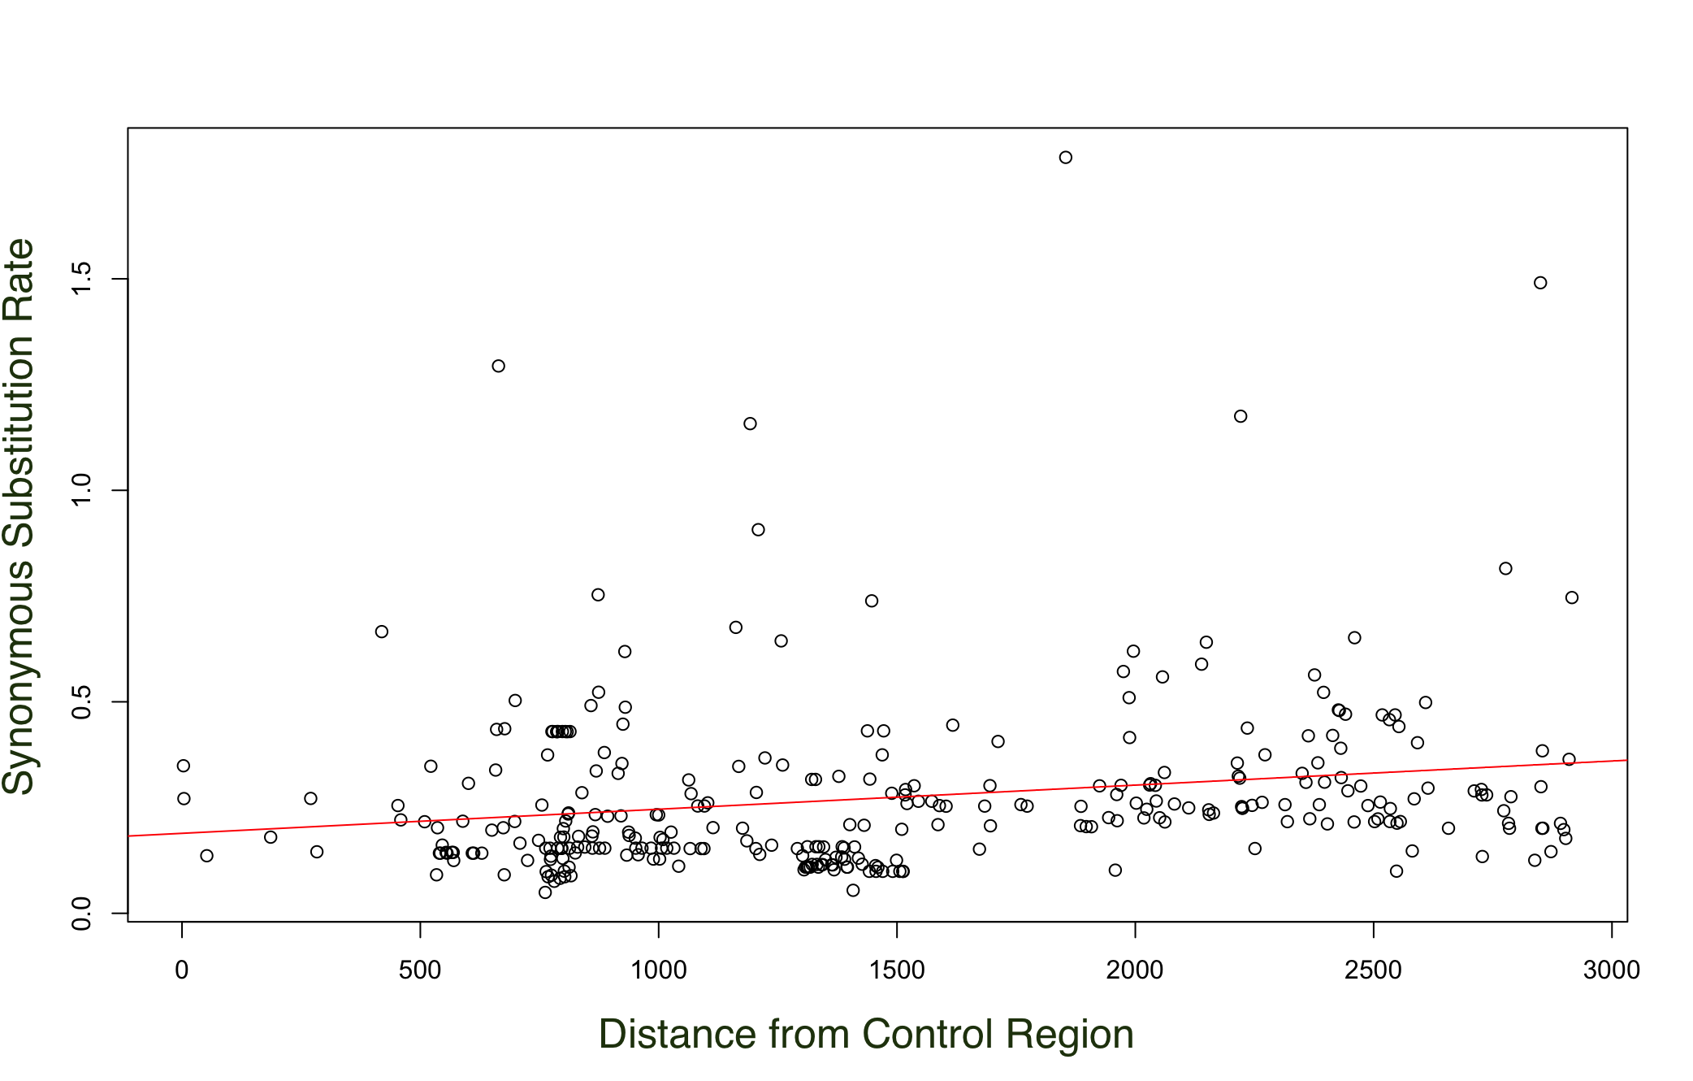
4. Scatter Plots
Unfiltered Madagascarophis Colubrinus
Filtered (0.7) Madagascarophis Colubrinus
Distance from Origin of Replication (WANCY)
Distance from Origin of Replication (WANCY)
Filtered by probability of positive and negative selection
Notes:
Ava
Getting rid of extreme positive and negative selection which is preventing data from replicating neutrally
Graph 1
Which will deviate the linear prediction?
The sites that are messy have things that are selected against for change they cannot change. If changed the organism will die bc they cant breed
Need to find parts of the mitochondria that can’t change
we are getting rid of extreme pos and neg selection
Filter → to find the substitutions that will occur neutrally
Substitutions are under too much or too little selection

Slide 13
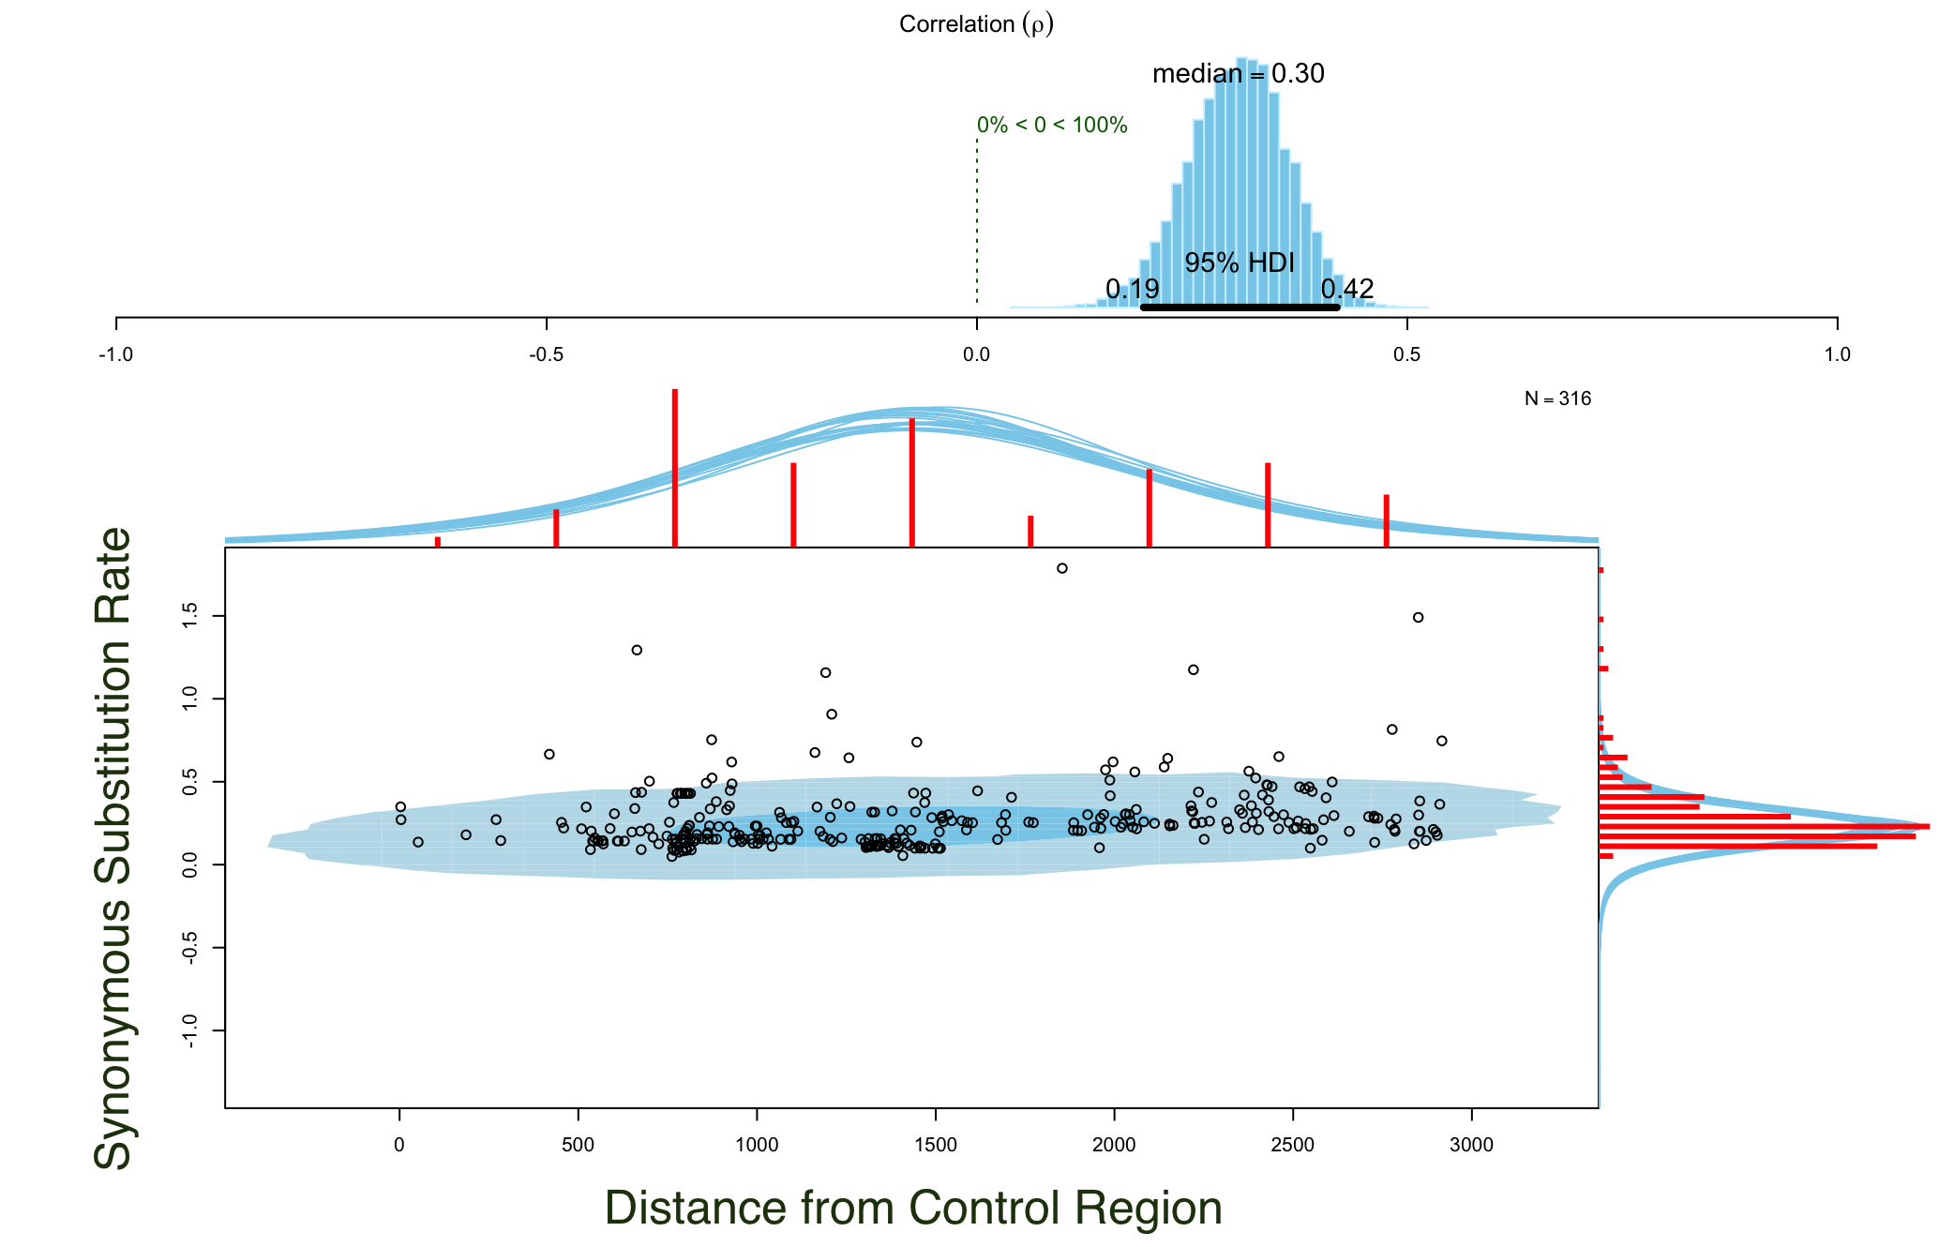
5. Bayesian Correlation Plots
Distance from Origin of Replication (WANCY)
Notes:
Ava
Getting rid of extreme positive and negative selection which is preventing data from replicating neutrally
Graph 1
Which will deviate the linear prediction?
The sites that are messy have things that are selected against for change they cannot change. If changed the organism will die bc they cant breed
Need to find parts of the mitochondria that can’t change
we are getting rid of extreme pos and neg selection
Filter → to find the substitutions that will occur neutrally
Substitutions are under too much or too little selection
Ours is very pos and it correlated with the distance of replication
Correlation is measured from -1 to 1
The closer it is to 0, the less correlated it is
If it’s positive, it’s increasing
If it’s negative, it’s decreasing
If it were not correlated then it would between 0 and negative
You need to highlight that the data is very correlated

Slide 14
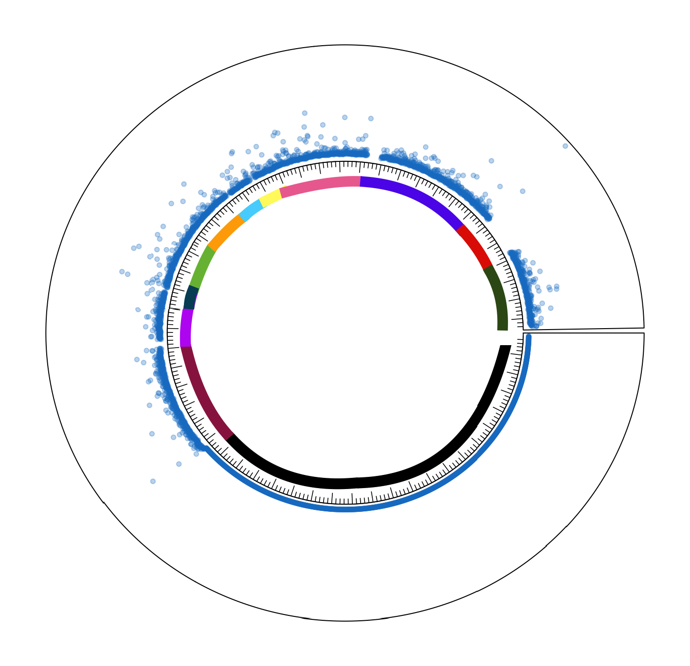
6. Circular Graphs
Beginning of control region 1
Key:
111111 = ND1, CR2, ND2, WANCY, 12S, 16S (no data)
111111 = COX1
111111 = COX2
111111 = ATP8
111111 = ATP6
111111 = COX3
111111 = ND3
111111 = ND4L
111111 = ND4
111111 = ND5
111111 = ND6
111111 = CYTB
Notes:
Ava
Its a visualization of the control region and the different parts of the genome

Slide 15
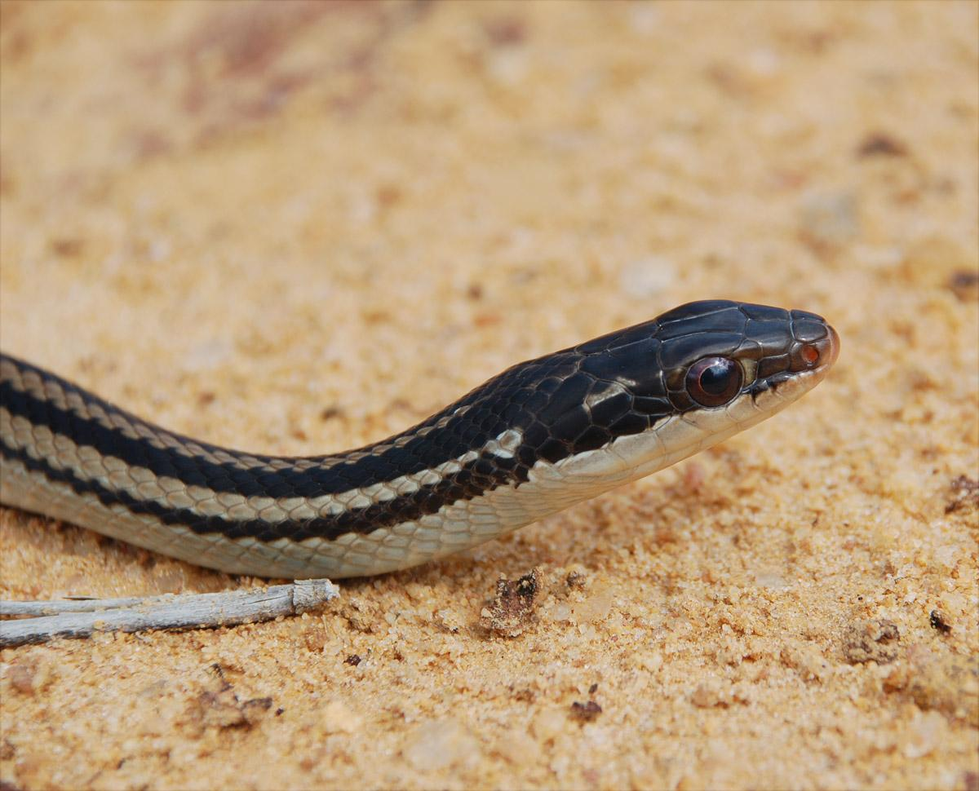
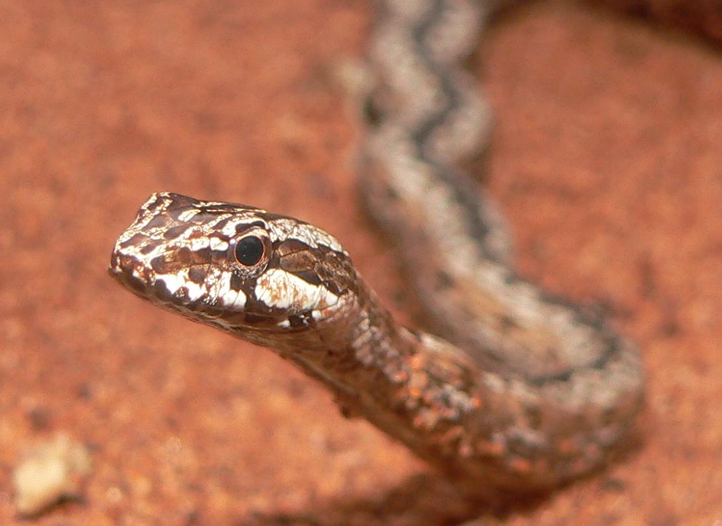
7. Comparison of Trend Among Species
12 individuals of Dromicodryas quadrilineatus
11 individuals of Mimophis mahfalensis
19 individuals of Madagascarophis colubrinus
80 species of the subfamily Pseudoxyrhophiinae
Notes:
Pics of each type of snake

Slide 16
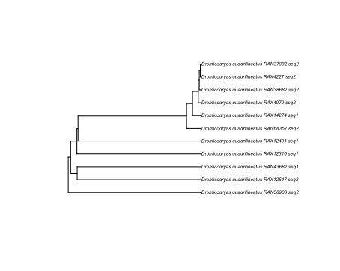
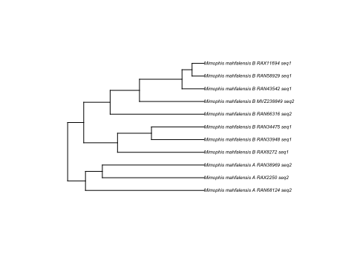
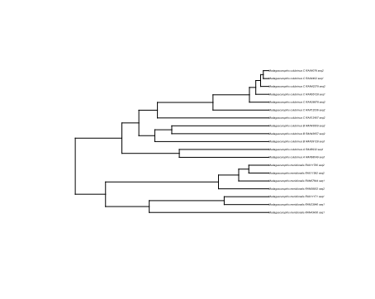
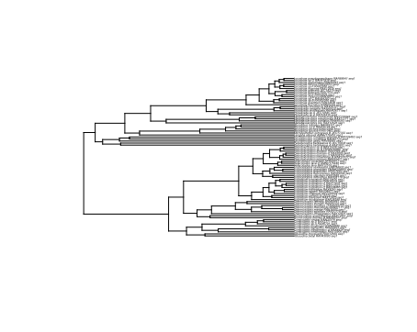
12 individuals of Dromicodryas quadrilineatus
11 individuals of Mimophis mahfalensis
19 individuals of Madagascarophis colubrinus
80 species of the subfamily Pseudoxyrhophiinae
Notes:
These are our pruned trees
The first three tree are based on 3 different madagascar snakes
Crystal
Renee tree doesnt have much structure so it doesnt have enought time to seprate or accumulate as much mutations
The first three trees are ..
Mulitple madgascar speces 8- diff specres
We used code to prune these tree to exact from the big tree
And then we used these tree from fubar

Slide 17
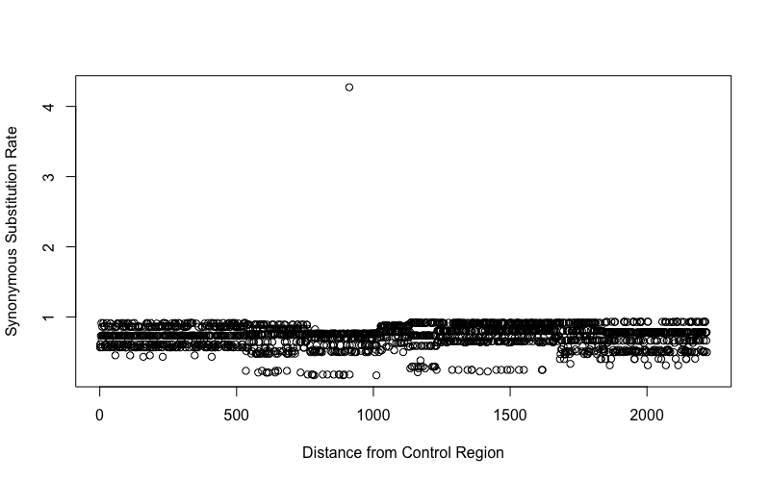
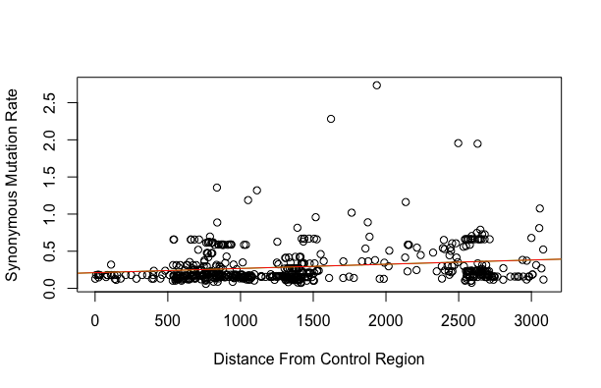
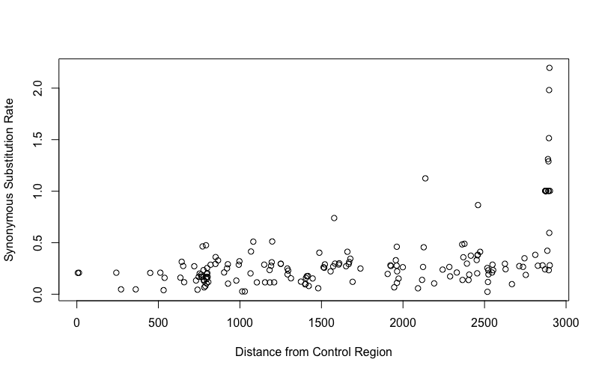
12 individuals of Dromicodryas quadrilineatus
11 individuals of Mimophis mahfalensis
Distance from Origin of Replication (WANCY)
Distance from Origin of Replication (WANCY)
19 individuals of Madagascarophis colubrinus
80 species of the subfamily Pseudoxyrhophiinae
Distance from Origin of Replication (WANCY)
Distance from Origin of Replication (WANCY)
Notes:
renee

Slide 18
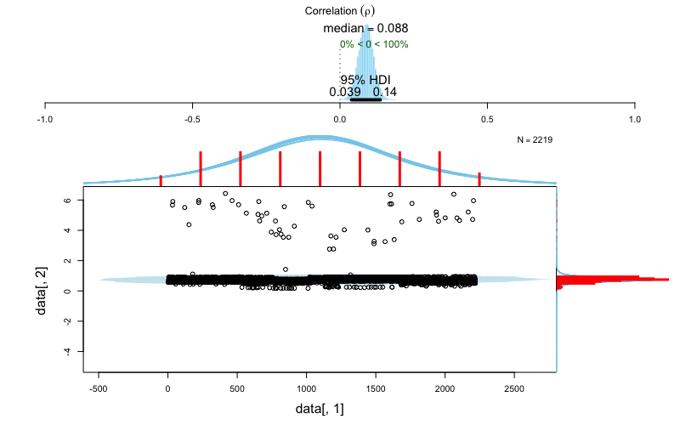
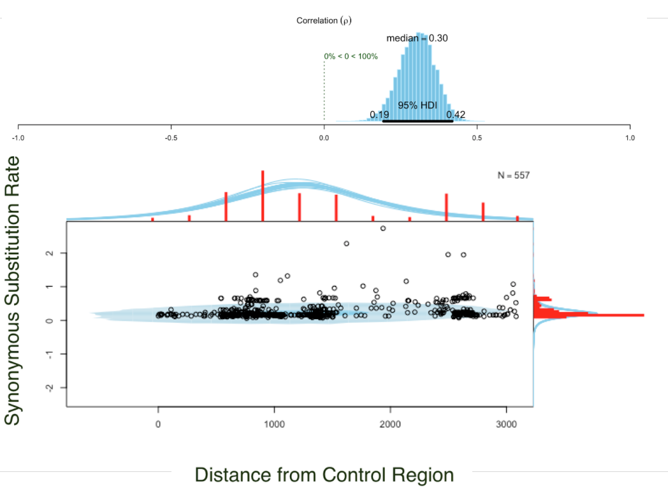
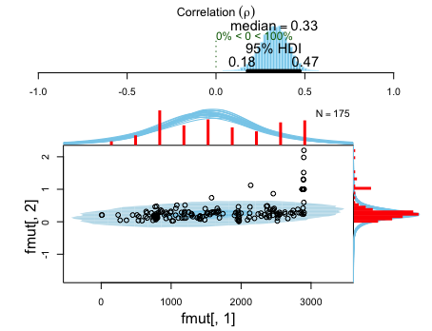
D. quadrilineatus
corr =
0.088
M. mahfalensis
corr =
0.30
Distance from Origin of Replication (WANCY)
Distance from Origin of Replication (WANCY)
M. colubrinus
corr =
0.30
Pseudoxyrhophiinae
corr =
0.33
Distance from Origin of Replication (WANCY)
Distance from Origin of Replication (WANCY)
Notes:
Renee
Dromicodryas is weak corr bc there is no population structure 3.9
-
-shows the correlation

Slide 19
General implications
Analysis between multiple species shows stronger trend than analysis between individuals
When individuals are too closely related, substitution hard to track
Supports general replication model with the first control region functional
Notes:
Species have to be divergent enough to pick up those substitutions

Slide 20
Next steps
Test if second control region is also functional -- equations
Regression line on circular graphs
Compare to ratsnake results (80 million years old)
Is trend stronger or weaker with older species?
Notes:
Now that we shown this our next step is to show
We have equation that is used and wnat to apply it to our date
Equation shows which one works
Problem/errors:
- wrong names of snakes
- wrong names of snakes in files
- files and tree did not match up
- by the time we saw the tree, the original data we had changed (two different madagascophis)
- some snakes not in tree (had to be excluded)
- geneious did not work out well
- we had to add spaces into the files
- we had to rerun things with a tree in fubar

Slide 21
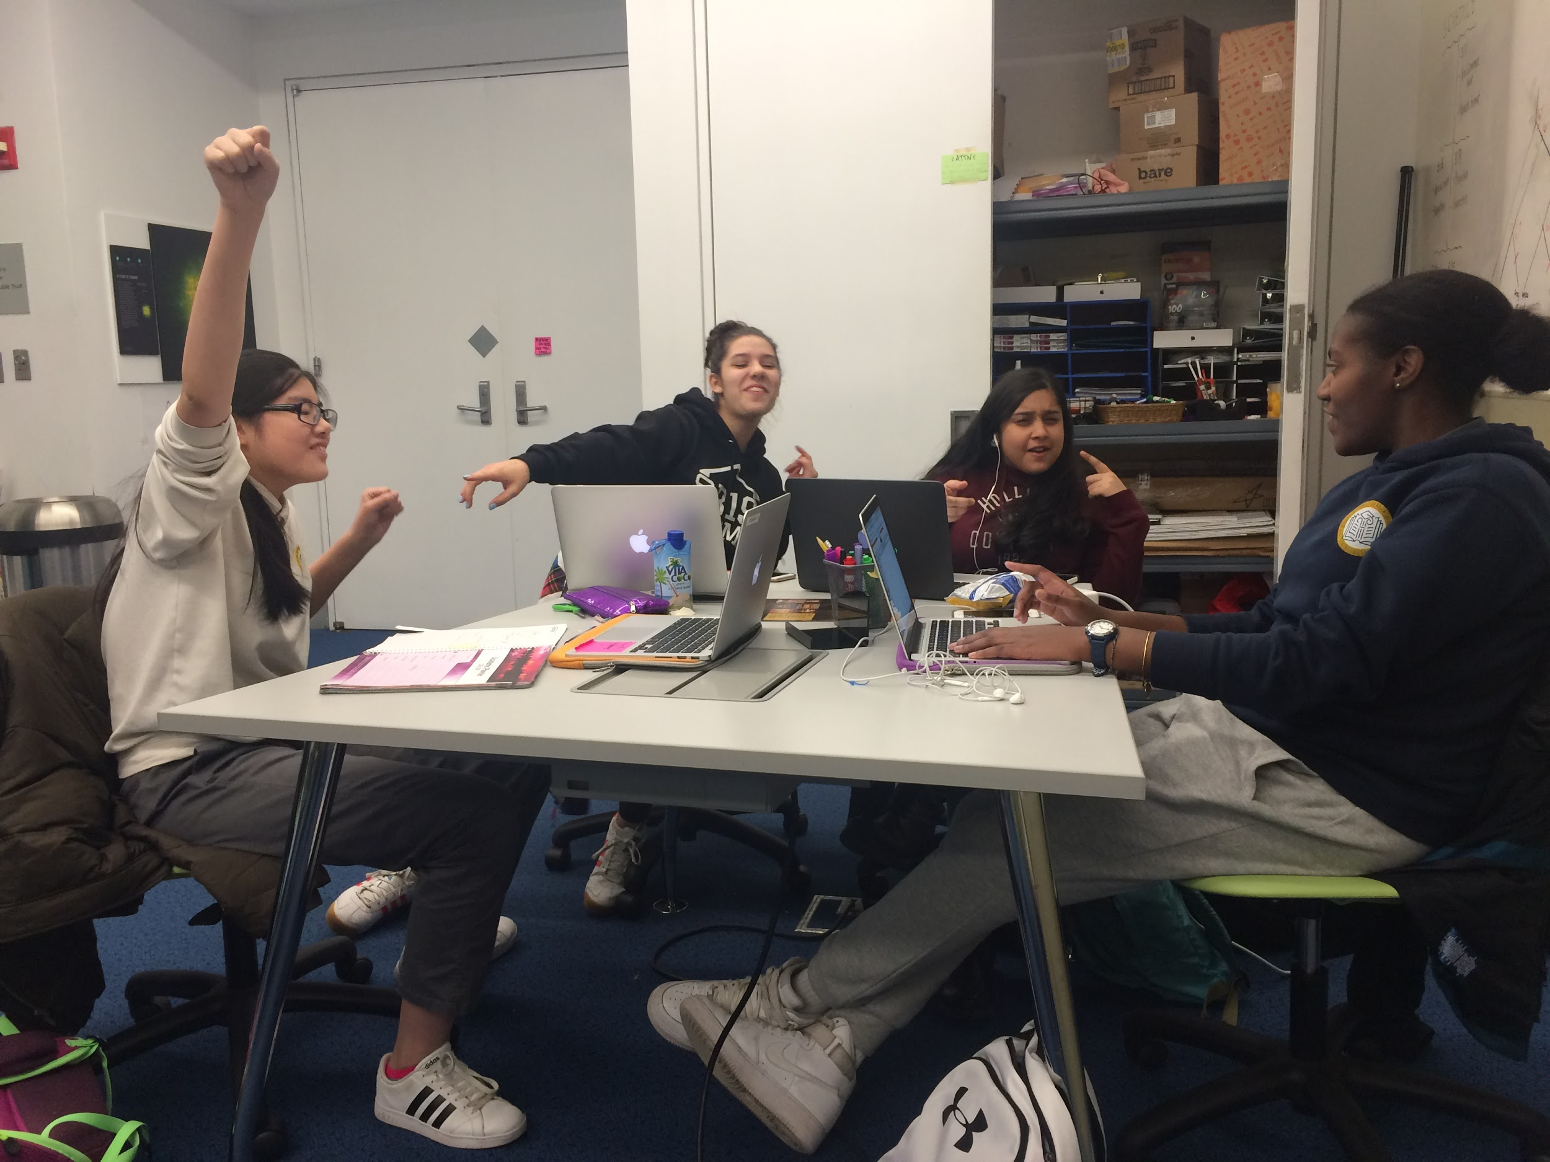
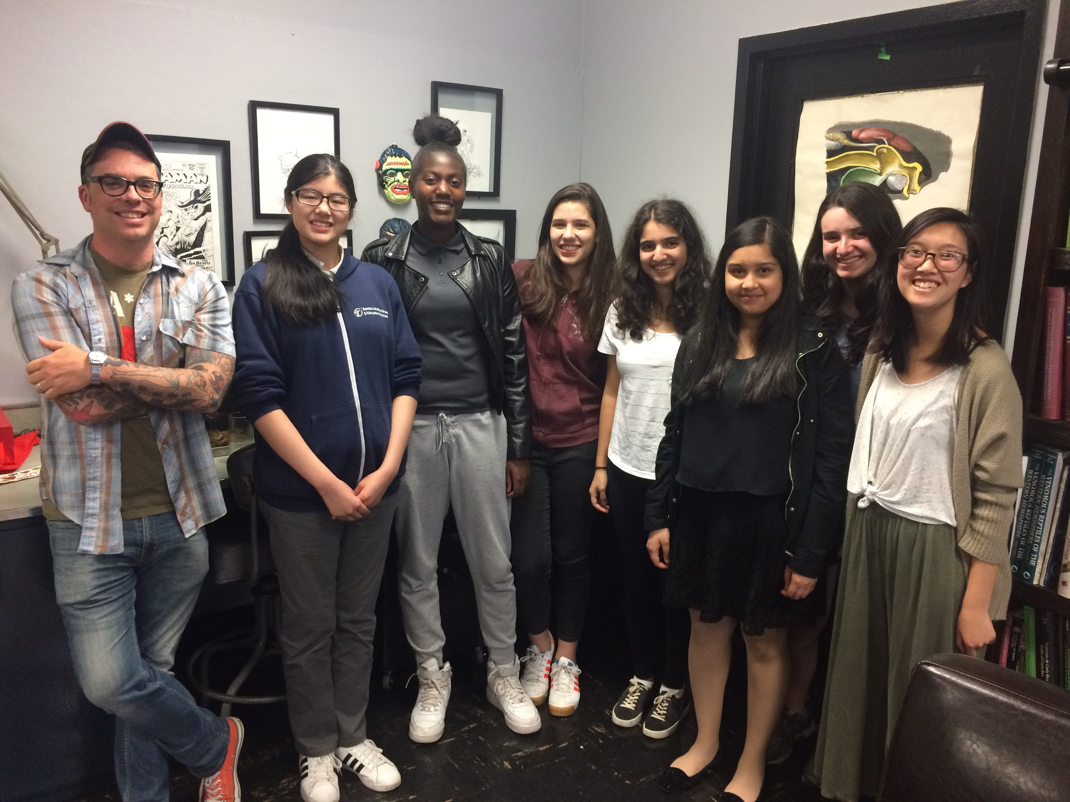
Acknowledgments
BridgeUp
Louise Crowley
Mali’o Kodis
Herpetology
Lauren Vonnahme
Arianna Kuhn
Marcelo Gehara
Frank Burbrink
Most of all…
Carolyn Sy

